Slide 1
Introduction to Machine Learning in Python

Slide 2


How do you make predictions?

Slide 3
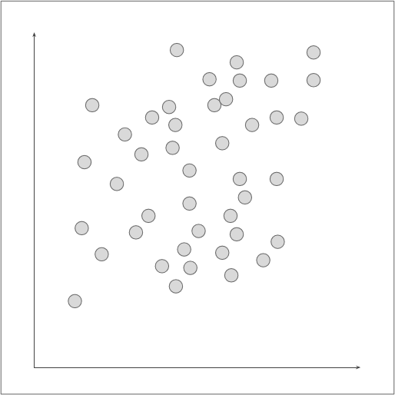
What patterns do you see?

Slide 4
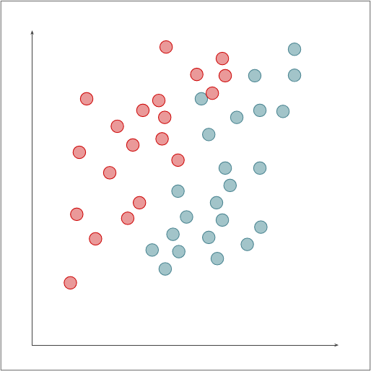
How do you determine red from blue?

Slide 5
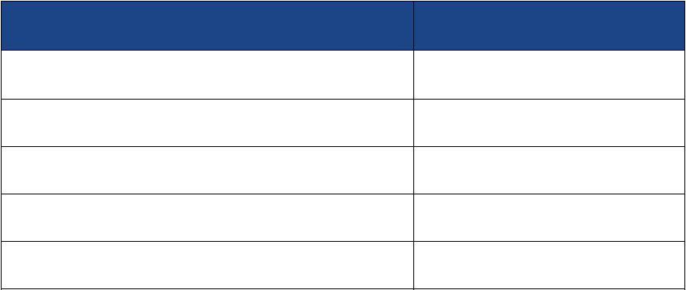
Types of Algorithms by Output
Input training data to fit a model which is then used to predict incoming inputs into ...
Type of Output
Algorithm Category
Output is one or more discrete classes
Classification (supervised)
Output is continuous
Regression (supervised)
Output is membership in a similar group
Clustering (unsupervised)
Output is the distribution of inputs
Density Estimation
Output is simplified from higher dimensions
Dimensionality Reduction

Slide 6



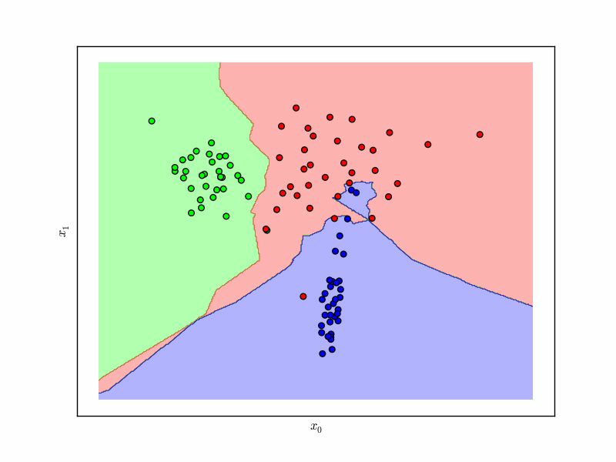
Classification
Given labeled input data (with two or more labels), fit a
function that can determine for any input, what the label is.

Slide 7
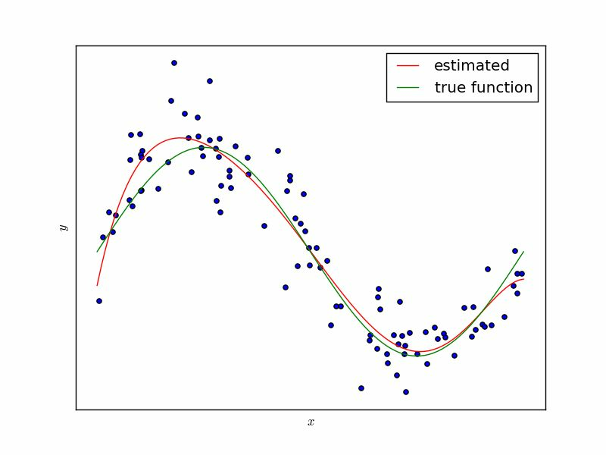
Regression
Given continuous input data fit a function that is able to
predict the continuous value of input given other data.

Slide 8
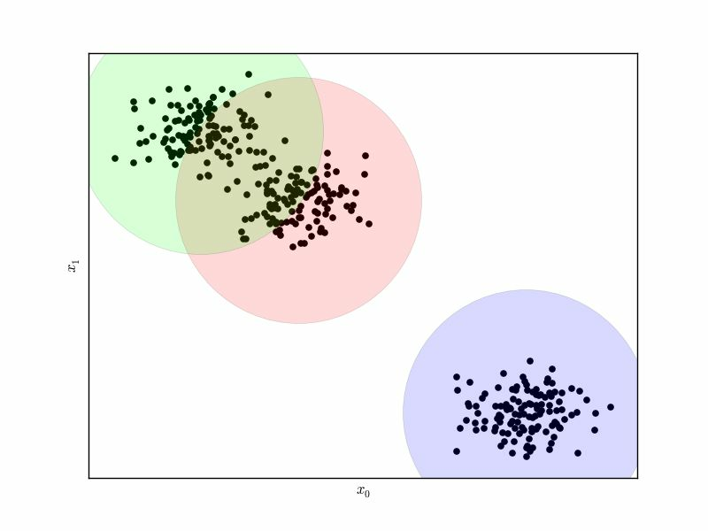
Clustering
Given data, determine a pattern of associated data points
or clusters via their similarity or distance from one another.

Slide 9
A Tour of Machine Learning
Algorithms

Slide 10
Models: Instance Methods
Compare instances in data set with a similarity measure to find best matches.
Suffers from curse of dimensionality.
Focus on feature representation and similarity metrics between instances
● k-Nearest Neighbors (kNN)
● Self-Organizing Maps (SOM)
● Learning Vector Quantization (LVQ)

Slide 11
Models: Regression
Model relationship of independent variables, X to dependent variable Y by iteratively optimizing error made in predictions.
Suffers from curse of dimensionality.
Focus on feature representation and similarity metrics between instances
● Ordinary Least Squares
● Logistic Regression
● Stepwise Regression
● Multivariate Adaptive Regression Splines (MARS)
● Locally Estimated Scatterplot Smoothing (LOESS)

Slide 12
Models: Decision Trees
Model of decisions based on data attributes. Predictions are made by following forks in a tree structure until a decision is made. Used for classification & regression.
● Classification and Regression Tree (CART)
● Decision Stump
● Random Forest
● Multivariate Adaptive Regression Splines (MARS)
● Gradient Boosting Machines (GBM)

Slide 13
Models: Clustering Methods
Organize data into into groups whose members share maximum similarity (defined usually by a distance metric). Two main approaches: centroids and hierarchical clustering.
● k-Means
● Affinity Propegation
●
OPTICS (Ordering Points to Identify Cluster Structure)
● Agglomerative Clustering

Slide 14
Models: Bayesian
Explicitly apply Bayes’ Theorem for classification and regression tasks. Usually by fitting a probability function constructed via the chain rule and a naive simplification of Bayes.
● Naive Bayes
● Averaged One-Dependence Estimators (AODE)
● Bayesian Belief Network (BBN)

Slide 15
Models: Kernel Methods
Map input data into higher dimensional vector space where the problem is easier to model. Named after the “kernel trick” which computes the inner product of images of pairs of data.
● Support Vector Machines (SVM)
● Radial Basis Function (RBF)
● Linear Discriminant Analysis (LDA)

Slide 16
Models: Artificial Neural Networks
Inspired by biological neural networks, ANNs are nonlinear function approximators that estimate functions with a large number of inputs.
● Perceptron
● Back-Propagation
● Hopfield Network
● Restricted Boltzmann Machine (RBM)
● Deep Belief Networks (DBN)

Slide 17
Models: Ensembles
Models composed of multiple weak models that are trained independently and whose outputs are combined to make an overall prediction.

Slide 18
An Architecture for Operationalizing
Machine Learning Algorithms

Slide 19

























Build Phase
Training Data
Feature
Vectors
Estimation
Algorithm
Labels
Operational Phase
New Data
Feature
Vector
Predictive
Model
Prediction
Architecture of Machine Learning Operations

Slide 20
What is Scikit-Learn?
Extensions to SciPy (Scientific Python) are called SciKits. SciKit-Learn provides machine learning algorithms.
Algorithms for supervised & unsupervised learning
Built on SciPy and Numpy
Standard Python API interface
Sits on top of c libraries, LAPACK, LibSVM, and Cython
Open Source: BSD License (part of Linux)

Slide 21


Where did it come from?
Started as a Google summer of code project in 2007 by David Cournapeau, then used as a thesis project by Matthieu Brucher.
In 2010, INRIA pushed the first public release, and sponsors the project, as do Google, Tinyclues, and the Python Software Foundation.

Slide 22


























Who uses Scikit-Learn?

Slide 23
Primary Features
Supervised learning algorithms
Cross-validation
Unsupervised learning algorithms
Various toy datasets
Feature extraction
Notes:
1. Think of any supervised learning algorithm you might have heard about and there is a very high chance that it is part of scikit-learn. Starting from Generalized linear models (e.g Linear Regression), Support Vector Machines (SVM), Decision Trees to Bayesian methods – all of them are part of scikit-learn toolbox. The spread of algorithms is one of the big reasons for high usage of scikit-learn. I started using scikit to solve supervised learning problems and would recommend that to people new to scikit / machine learning as well.
2. There are various methods to check the accuracy of supervised models on unseen data.
3. Again there is a large spread of algorithms in the offering – starting from clustering, factor analysis, principal component analysis to unsupervised neural networks.
4. This came in handy while learning scikit-learn. I had learnt SAS using various academic datasets (e.g. IRIS dataset, Boston House prices dataset). Having them handy while learning a new library helped a lot.
5. Useful for extracting features from images and text (e.g. Bag of words)

Slide 24
A Guide to Scikit-learn
https://scikit-learn.org/stable/tutorial/machine_learning_map/
Notes:
There’s a machine_learning_map available on scikit learn’s website that we can use as a quick reference when choosing an algorithm. It looks something like this:

Slide 25
General Steps
Step 1: Import the relevant libraries and read the dataset
Step 2: Understand the dataset by looking at distributions and plots
Step 3: Build a prediction model on the dataset and making predictions
Step 4: Print accuracy

Slide 26
Estimators
fit(X,y) sets the state of the estimator.
- X is usually a 2D numpy array of shape
y is a 1D array with shape (n_samples,)
predict(X) returns the class or value
predict_proba() returns a 2D array of shape (n_samples, n_classes)
(num_samples, num_features)

Slide 27

from sklearn import svm
estimator = svm.SVC(gamma=0.001)
estimator.fit(X, y)
estimator.predict(x)
Basic methodology
Notes:
Support Vectors Classifier tries to find the best hyperplane to separate the different classes by maximizing the distance between sample points and the hyperplane.
gamma is a parameter for non linear hyperplanes. The higher the gamma value it tries to exactly fit the training data set

Slide 28









Wrapping fit and predictators
We’ve already discussed a broad workflow, the following is a development workflow
Raw Data
Feature
Extraction
Feature
Evaluation
Load &
Transform Data
Build Model
Evaluate Model

Slide 29
Wrapping fit and predictators
We’ve already discussed a broad workflow, the following is a development workflow
Raw Data
Feature
Extraction
Feature
Evaluation
Load &
Transform Data
Build Model
Evaluate Model

Slide 30
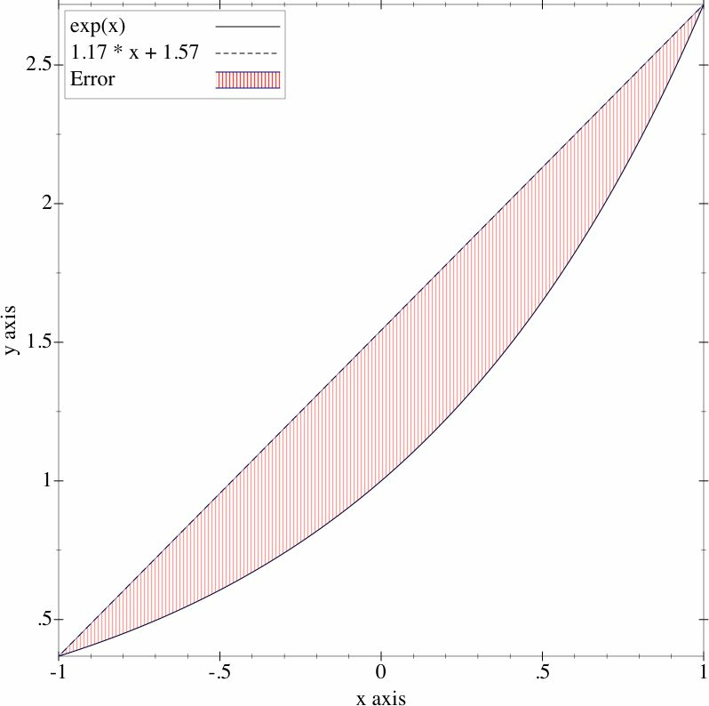
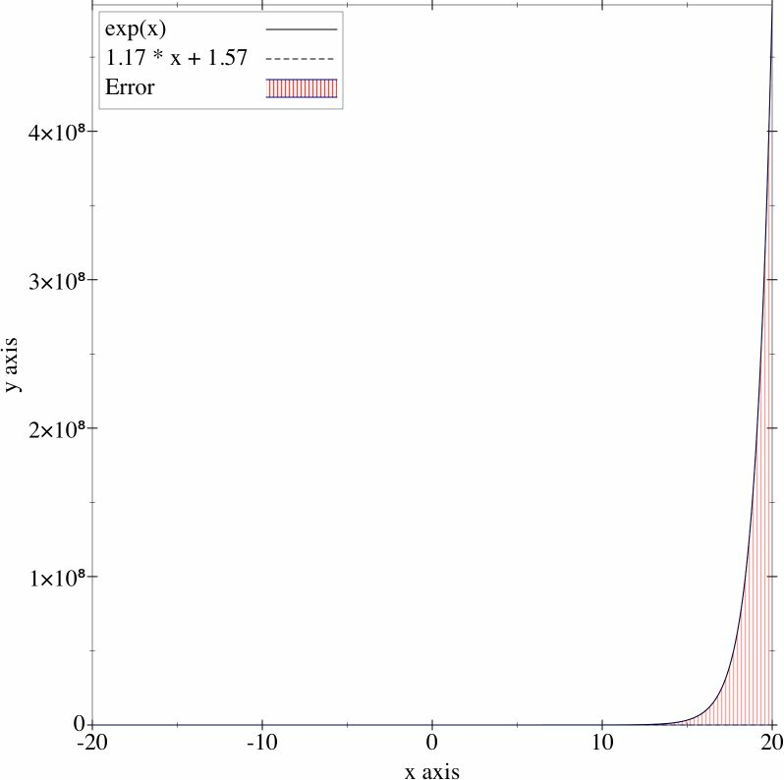
Underfitting
Not enough information to accurately model real life.
Can be due to high bias, or just a too simplistic model
Solution: Cross Validation

Slide 31


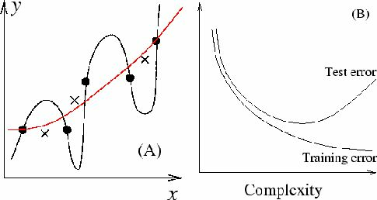
Overfitting
Create a model with too many parameters or is too complex. “Memorization of the data” - and the model can’t generalize very well.
Solution: Benchmark Testing, Ridge Regression,
Feature Analyses, Dimensionality Reduction

Slide 32
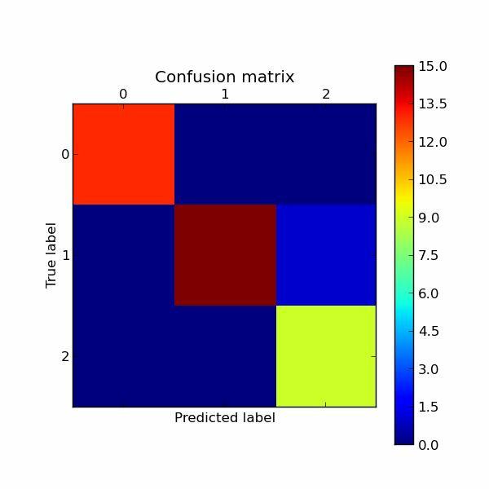

Cross Validation (classification)
Assess how model will generalize to independent data set
(e.g. data not in the training set).
1. Divide data into training and test splits
2. Fit model on training, predict on test
3.
4.
Determine accuracy, precision and recall
Repeat k times with different splits then average as F1
Predicted Class A
Predicted Class B
Actual A
True A
False B
#A
Actual B
False A
True B
#B
#P(A)
#P(B)
total

Slide 33


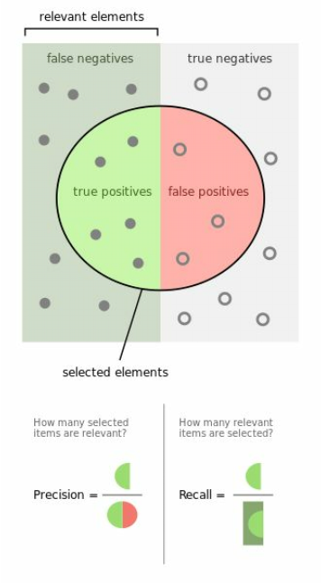
accuracy =
(true positives + true
Negatives) / total
precision =
true positives / (true
positives + false positives)
recall =
true positives / (false
negatives + true positives)
F1 score =
2 * ((precision * recall) /
(precision + recall))
https://en.wikipedia.org/wiki/Precision_and_recall
Notes:
Accuracy - Accuracy is the most intuitive performance measure and it is simply a ratio of correctly predicted observation to the total observations. One may think that, if we have high accuracy then our model is best. Yes, accuracy is a great measure but only when you have symmetric datasets where values of false positive and false negatives are almost same. Therefore, you have to look at other parameters to evaluate the performance of your model. For our model, we have got 0.803 which means our model is approx. 80% accurate.
Accuracy = TP+TN/TP+FP+FN+TN
Precision - Precision is the ratio of correctly predicted positive observations to the total predicted positive observations. The question that this metric answer is of all passengers that labeled as survived, how many actually survived? High precision relates to the low false positive rate. We have got 0.788 precision which is pretty good.
Precision = TP/TP+FP
Recall (Sensitivity) - Recall is the ratio of correctly predicted positive observations to the all observations in actual class - yes. The question recall answers is: Of all the passengers that truly survived, how many did we label? We have got recall of 0.631 which is good for this model as it’s above 0.5.
Recall = TP/TP+FN
F1 score - F1 Score is the weighted average of Precision and Recall. Therefore, this score takes both false positives and false negatives into account. Intuitively it is not as easy to understand as accuracy, but F1 is usually more useful than accuracy, especially if you have an uneven class distribution. Accuracy works best if false positives and false negatives have similar cost. If the cost of false positives and false negatives are very different, it’s better to look at both Precision and Recall. In our case, F1 score is 0.701.
F1 Score = 2*(Recall * Precision) / (Recall + Precision)
https://blog.exsilio.com/all/accuracy-precision-recall-f1-score-interpretation-of-performance-measures/

Slide 34

from sklearn import metrics
from sklearn import cross_validation as cv
splits = cv.train_test_split(X, y, test_size=0.2)
X_train, X_test, y_train, y_test = splits
model = ClassifierEstimator()
model.fit(X_train, y_train)
expected = y_test
predicted = model.predict(X_test)
print metrics.classification_report(expected, predicted)
print metrics.confusion_matrix(expected, predicted)
print metrics.f1_score(expected, predicted)
Cross Validation in Scikit-Learn

Slide 35
MSE & Coefficient of Determination
In regressions we can determine how well the
model fits by computing the mean square error
and the coefficient of determination.
MSE = np.mean((predicted-expected)**2)
2
R is a predictor of “goodness of fit” and is a
value ∈ [0,1] where 1 is perfect fit.

Slide 36

from sklearn import metrics
from sklearn import cross_validation as cv
splits = cv.train_test_split(X, y, test_size=0.2)
X_train, X_test, y_train, y_test = splits
model = RegressionEstimator()
model.fit(X_train, y_train)
expected = y_test
predicted = model.predict(y_test)
print metrics.mean_squared_error(expected, predicted)
print metrics.r2_score(expected, predicted)
K-Part Cross Validation

Slide 37


Unpredictable Future
Machine learning models attempt to predict the future
as new inputs come in - but human systems and
processes are subject to change.
Solution: Precision/Recall tracking over time

